Slide 1
Data Mining on Airbnb New Users First bookings
02/22/2018

Slide 2
Problem to Solve
Predict where would the new users book their first booking
Based on:
personal information (gender, age, etc.)
web activity information (signup method, affiliate channel, first browser, etc.)
Multiclass classification problem

Slide 3
Potential Clients
Airbnb or other websites for vacation rentals
Push notifications or send promotions about a specific place
New users would have a higher possibility to book in their website or to start their first booking in a shorter time

Slide 4
Data Set Information
Airbnb new users booking Kaggle competition website train_users_2 csv file
Record 213,451 new users’ personal information and their web activity information as well as their country destination of first booking
Input variables: categorical, numerical and time series
Output variable: country destination (multiple classes)

Slide 5
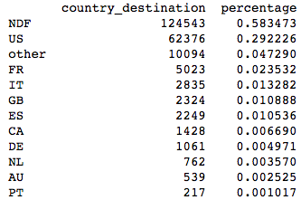
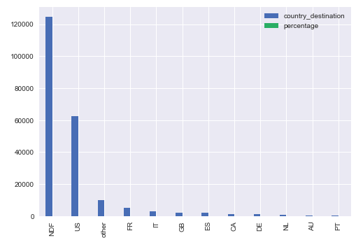
Data Exploration and Initial Findings
Country destination

Slide 6
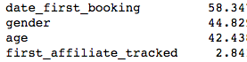
Data Exploration and Initial Findings
Nan values percentage

Slide 7
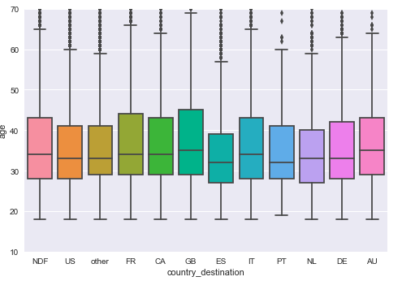
Data Exploration and Initial Findings
Age

Slide 8
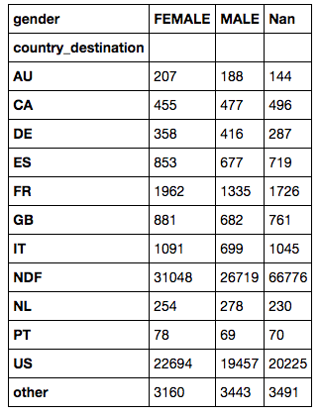
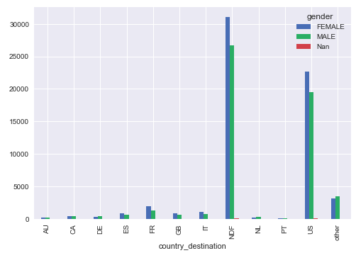
Data Exploration and Initial Findings
Gender

Slide 9
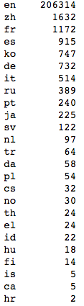
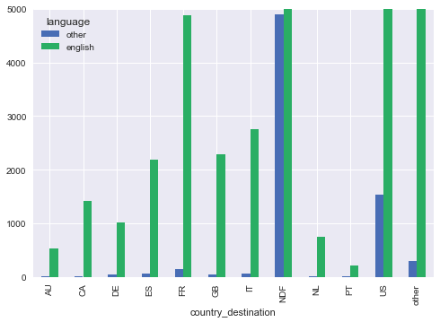
Data Exploration and Initial Findings
Language

Slide 10
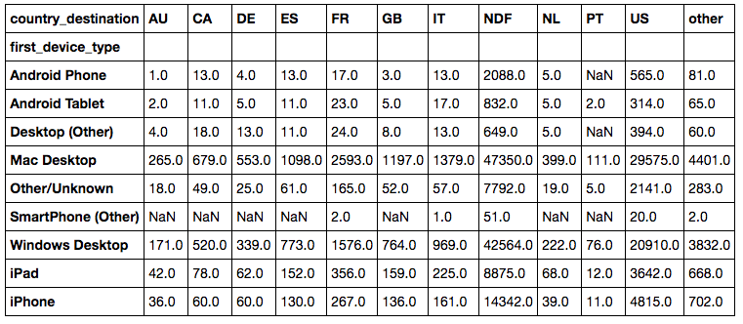
Data Exploration and Initial Findings
First device type

Slide 11
Data Exploration and Initial findings
For the time series variables, more than 99% of the calculated gap month or gap days between first active and account create are zero. Most new users created account at the same day of their first active date. First booking dates are separated as first booking years and first booking months. Value counts show that there are no extreme values or highly skewed distributions in years or months.
For other categorical variables, some of them have very small category size (smaller than 100) but most of the categories have their own meanings and are not suitable to combine with other categories.

Slide 12
Initial findings
There are many unknown values in this dataset.
More than half of the new users do not have their first bookings and it might be appropriate to build sequential models to first predict whether the new users would make first booking and then take the new users who predicted positive to further predict where would their first booking be.

Slide 13
Data Wrangling
Categorical variables:
Dummy variable method used for separating categories and the first category is dropped to avoid high correlation among features
Each category is usually left alone unless the size of the category is very small and it is reasonable to combine with another or some other categories.

Slide 14
Data Wrangling
Time series variables:
First active dates and account create dates: calculated the gap days between these two but value count result showed that most of the entries are zero, so the gap days variable is removed.
First booking dates: removed since the problem here is to predict where would a new user’s first booking be and at that time the first booking time would not be known.

Slide 15
Data Wrangling
Numerical variable:
Age is rearranged as categorical:
Ages higher than 95 or lower than 18 grouped with nan values
Ages between 18 and 29: young people
Ages between 30 and 54: middle age people
Ages between 55 and 95: old people

Slide 16
In-depth Analysis – Training Algorithms
Three-model ensemble trained by 70% of the whole dataset is first used to predict whether the new users would make first bookings. Then the new users who predicted will be taken to the second voting classifier combining all three models trained by 70% of data entries that had first bookings to predict where would the new users make their first bookings.
Voting classifier is used to combine three models as ensemble. Hard voting is chosen to take the major vote from all three models.
Three individual models: linearSVC, random forest classifier and gradient boosting classifier

Slide 17
In-depth Analysis – Criterial Tool
Classification report
shows the precision, recall, f1 score and support numbers of all classes
All three scores are used to determine which model would be better. Since the dataset is imbalanced, more attention are paid to the improvement of scores for classes that have small numbers of samples.

Slide 18
In-depth Analysis – Imbalanced Data
58% of the new users have not booked yet, 29% of the users who had first bookings went to United States and some destinations such as Australia and Portugal have less than 1% data entries.
To deal with the imbalance that more than half of the new users have not made first bookings, use a binary classification followed by a multi-class classification.
To deal with the other country destinations’ imbalance, set class_weight=’balanced’ in all the individual models that have this parameter.

Slide 19
In-depth Analysis – Cross Validation
Randomly shuffle the data
Split the data to 70% training set, 20% test set and 10% final set
Training set used for fitting the models and tune parameters
Test set used to validate and compare the performance of the fitted models

Slide 20
In-depth Analysis – Parameters Tuning
GridSearchCV method
Cross validation: five-fold
Scoring function: accuracy classification score

Slide 21
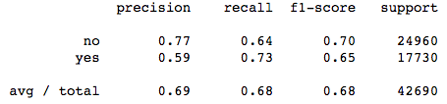
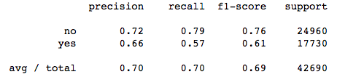
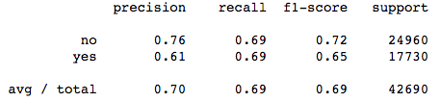
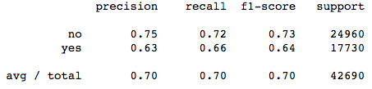
In-depth Analysis – Results Analysis
Predict whether the new users would make first bookings
LinearSVC
Gradient boosting classifier
Random forest classifier
Voting Classifier (ensemble)

Slide 22
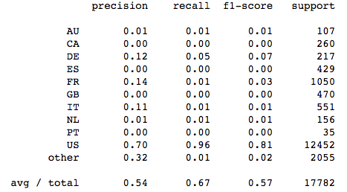
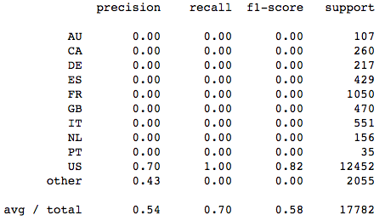
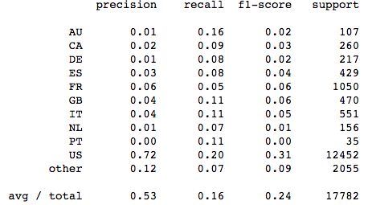
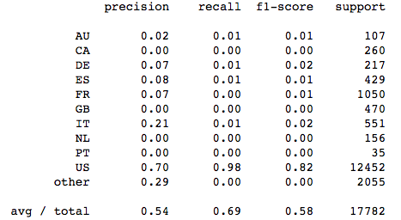
In-depth Analysis – Results Analysis
For new users who would make first booking, predict where the new users first bookings would be
LinearSVC
Gradient boosting classifier
Random forest classifier
Voting Classifier (ensemble)

Slide 23
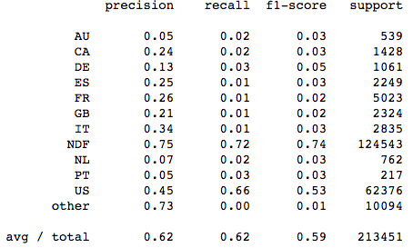
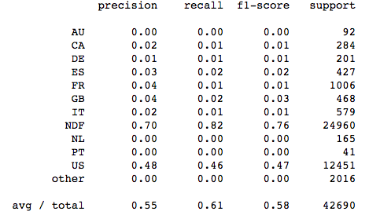
In-depth Analysis – Results Analysis
Two built model ensembles fed sequentially
One built model ensemble

